Slide 1





Slide 2

Serves all
  students of the university,
  staff members, with medical needs
Staff
  Doctor
  Pharmacist
  Nurse

Slide 3

Task | Current Pocedure | Proposed System
Patient Records | File based | In Database
Paitent registration/ record access | Hand written Through personal file | Authentication through bar code of ID
Stock management | File based | Database Prior notification about expiration dates
Reports | Hand written | Printed
Efficiency/ Easiness | Very low | Very high
Security | low | high

Slide 4

Easiness in managing patients’ records and stock details increased.
Proper procedure to treat Academic and Non-academic staff can be introduced using a database.
Every student can obtain a full medical report when leaving the University.
Generate daily summary reports.
Obtain a printed medical certificate easily.

Slide 5

Add, update or remove a patient
Validate the patient using barcode in the University ID.
Add, update or remove stock details
Record medicines prescribed for the patient and generate a message if the prescribes medicine is out of stock.
View patient history
Generate and print summary report for the day.
Generate a report for the available drugs.
Generate a message informing the drugs-to-be-expired before 3 months.
Print a report about the out of stock drugs
Generate and print medical reports for students on request.
Generate and print the reports on inventory objects.

Slide 6

Increasing the Performance of the system
Security
Scalability
Maintainability
Usability
Efficiency

Slide 7




Doctor - Administrator
Pharmacist/
Nurse

Slide 8

Doctor | Pharmacist/Nurse
Prescribe medicine to patient View Patient’s history View drug stocks Generate medical report for the student Generate daily summary report Generate and print medical certificate for absent lectures. | Register a new patient Remove a patient Update patient details Update stock details View drug stocks Generate daily summary report

Slide 9

Computer with Server facility
Internet Facilities
Barcode reader
Printer

Slide 10

Operating System: Microsoft Windows 8/8.1/10
Java, java development kit (jdk)
MySQL
Wamp server

Slide 11

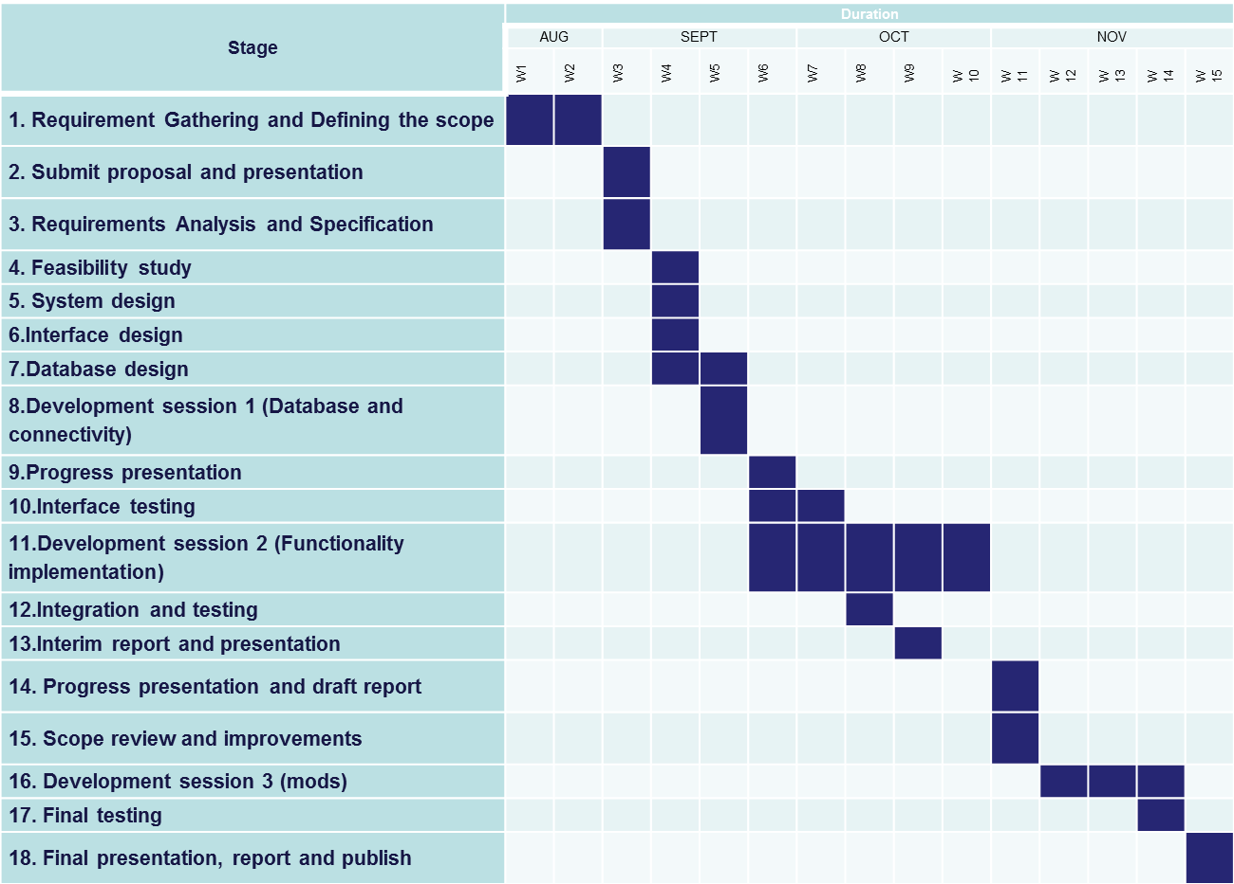

Slide 12


Byravi T UWU/CST/15/005
Karunarathne K.R.R. UWU/CST/15/016
Mathushanth S. UWU/CST/15/027
Sajitha S. UWU/CST/15/039
Wanigarathne J.A.G.A. UWU/CST/15/052

Slide 13
